Slide 1
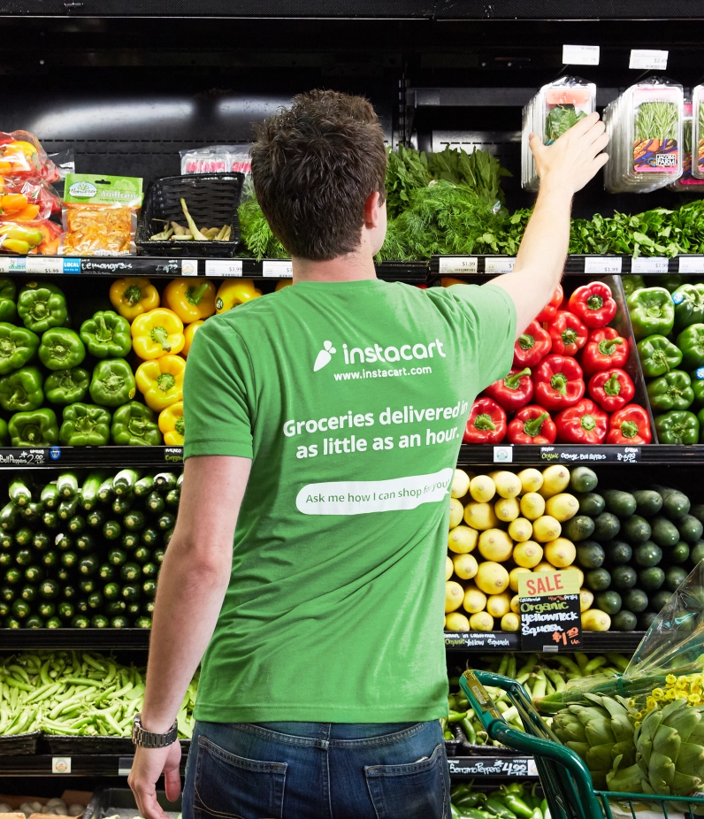

Instacart: Market Basket Analysis
Group Y:
João Alves Henriques;
João Paulo César
Pedro Sancho
Vilmar Adriano Bussolaro

Slide 2
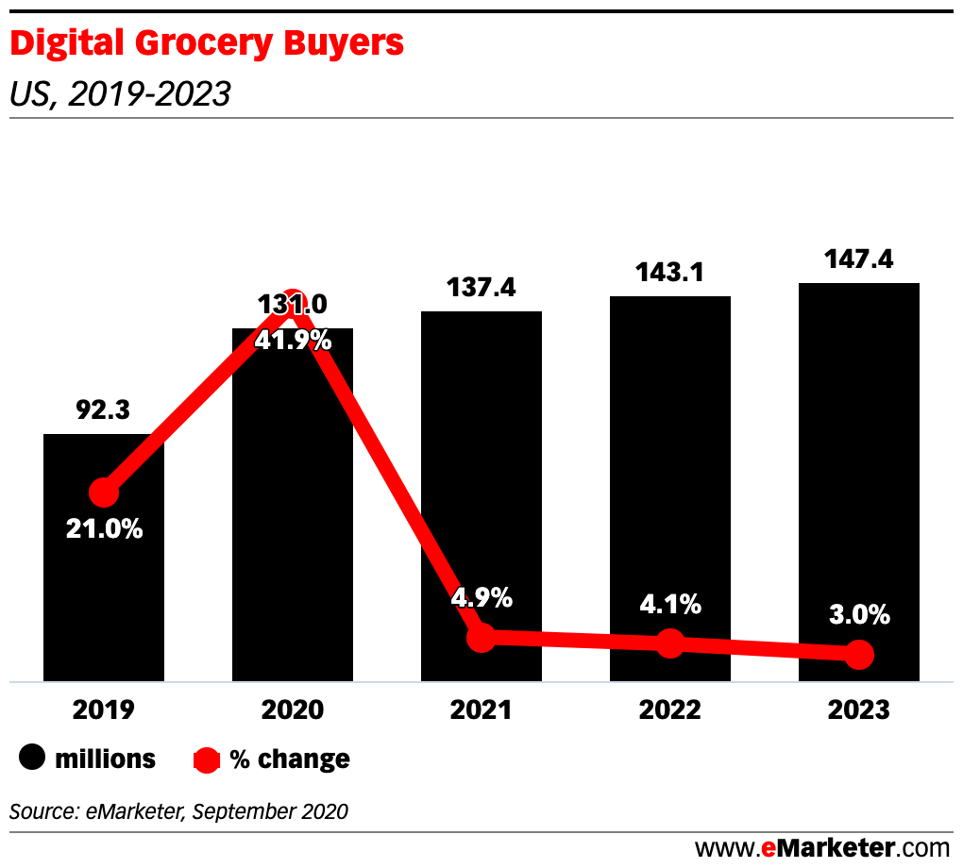
Context
COVID-19 has accelerated the trend on e-grocery

Slide 3

Context
COVID-19 has accelerated the trend on e-grocery
Instacart is a major player in the industry
Instacart e-commerce market share during the coronavirus pandemic in the US from January to April 2020

Slide 4

Context
Situation:
Instacart wants to better understand consumer buying behavior:
Market Basket Analysis with apriori algorithm
Which types of products should have an extended amount of product offerings?
Which types of products can be seen as substitutes?
Which items are complementary?
Clustering with k-means
What are the main types of consumer behavior in the business?

Slide 5

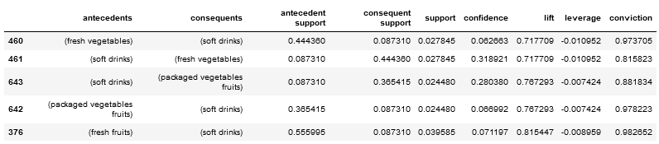
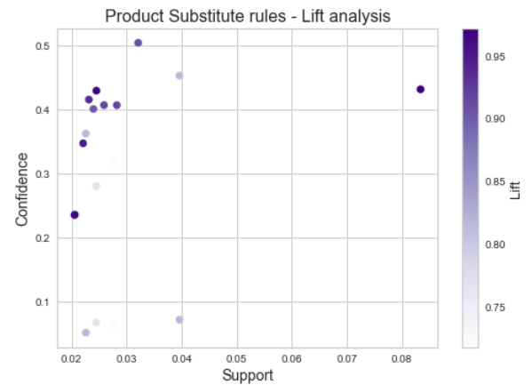
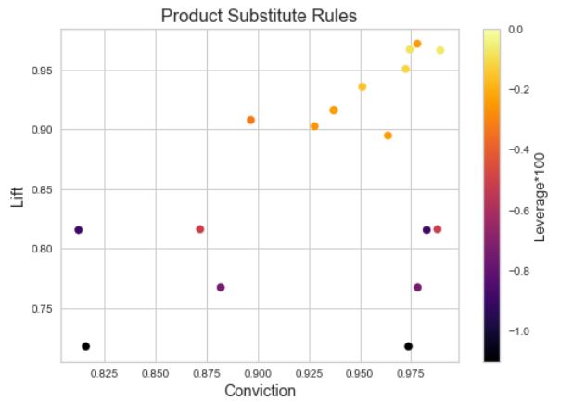
Data Mining
SUBSTITUTE PRODUCTS – Rules for fine-tuning the algorithm
Lift < 1.0
Conviction < 0.95

Slide 6
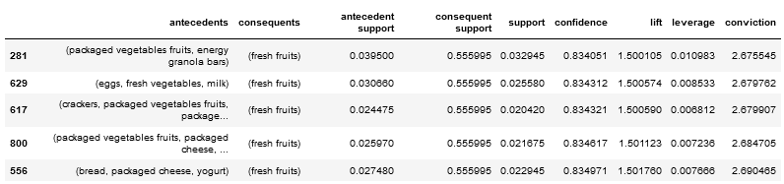
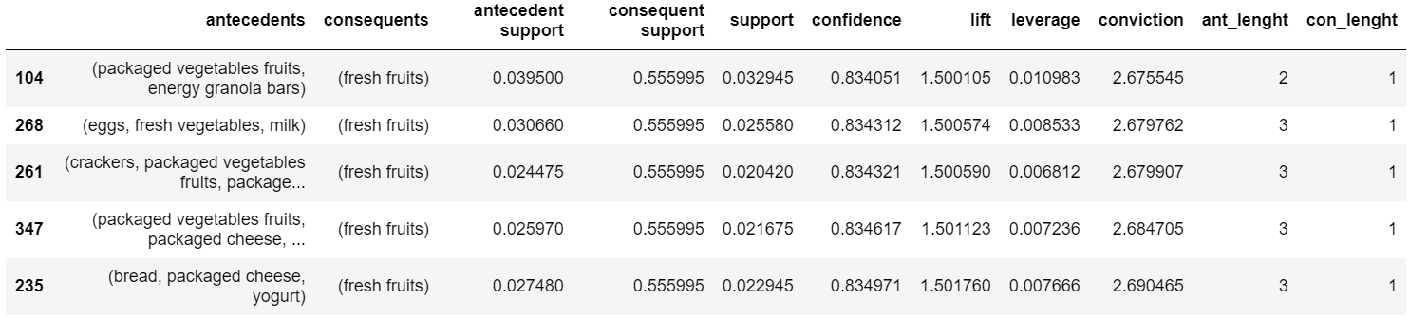
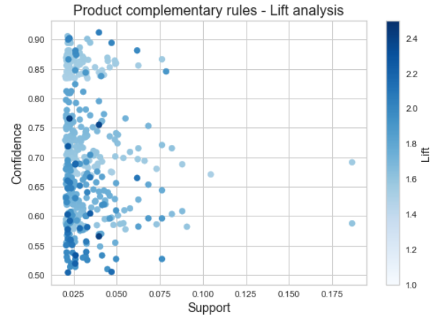
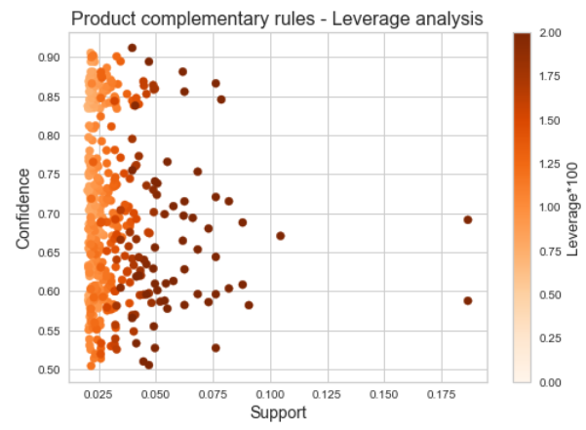
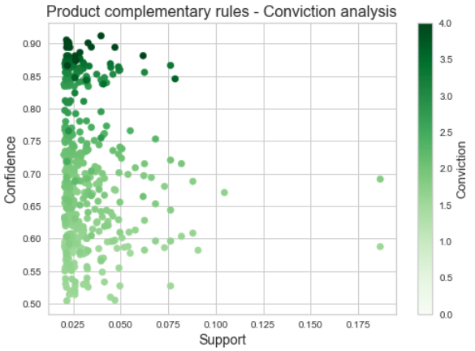
Data Mining
COMPLEMENTARY PRODUCTS – Rules for fine-tuning the algorithm
Confidence > 0.7
Lift > 1.5
Conviction > 1.5
Notes:
(fresh vegetables) 145
(packaged vegetables fruits) 127
(fresh fruits) 74
(fresh fruits, fresh vegetables) 50
(fresh fruits, packaged vegetables fruits) 21
(yogurt) 9
(fresh vegetables, packaged vegetables fruits) 4
(packaged cheese) 1

Slide 7
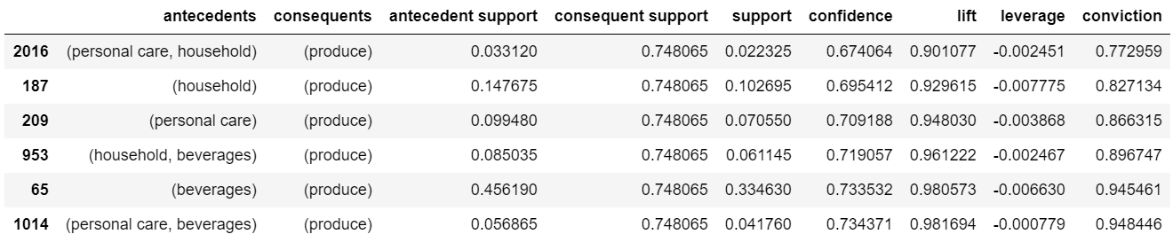
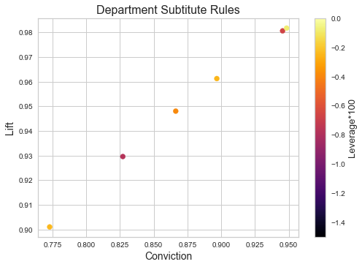
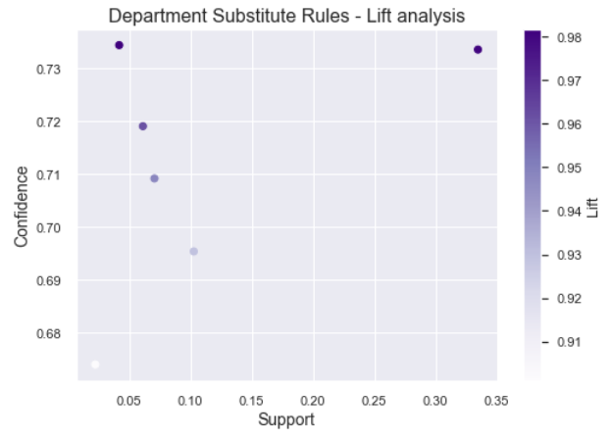
Data Mining
SUBSTITUTE DEPARTMENTS – Rules for fine-tuning the algorithm
Lift < 1.0
Conviction < 0.99

Slide 8
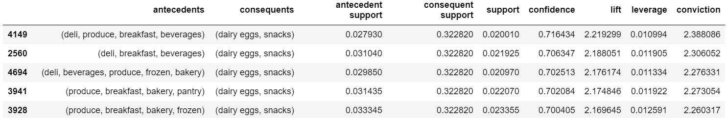
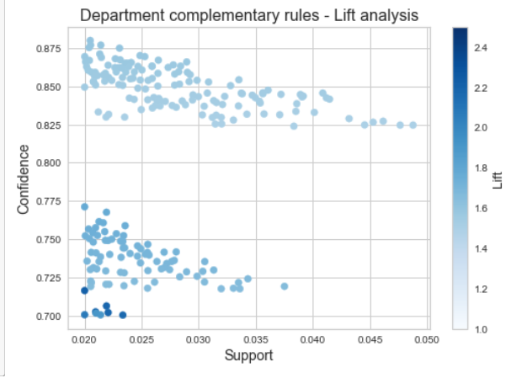
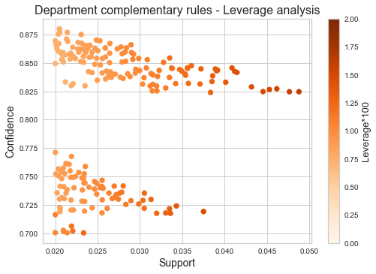
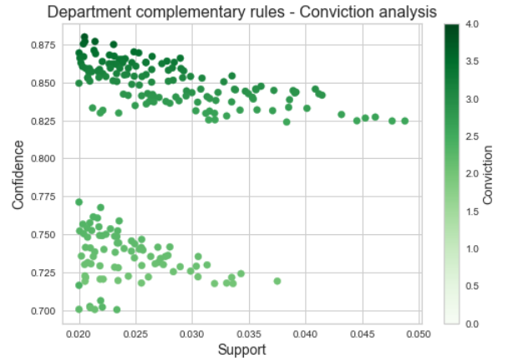
Data Mining
COMPLEMENTARY DEPARTMENTS – Rules for fine-tuning the algorithm
Confidence > 0.5
Lift > 1.5
Conviction > 1.5

Slide 9
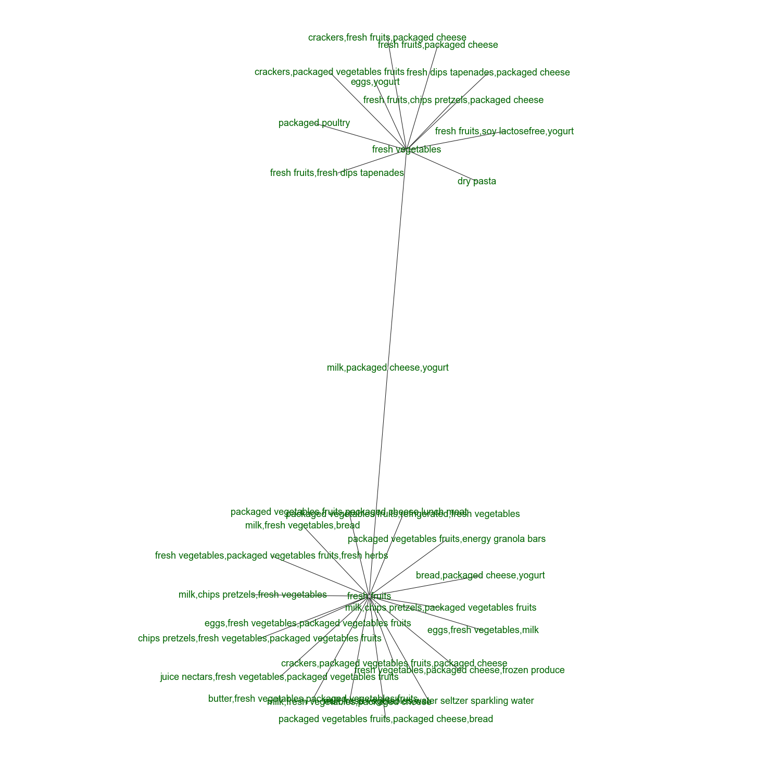
Results
Which types of products should have an extended amount of product offerings?
Fresh products, like:
Fresh fruits
Packaged vegetables & fruits
Bakery
Eggs and milk derivatives

Slide 10
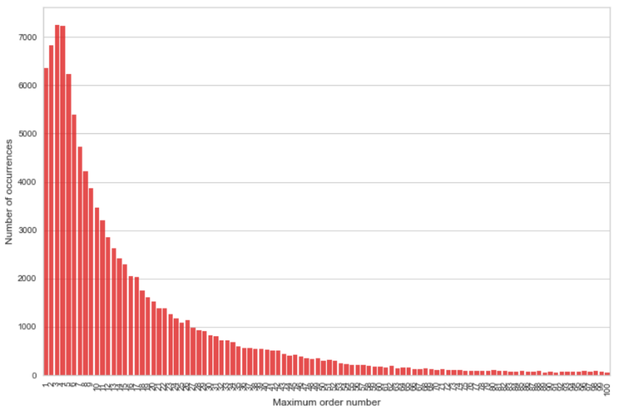
Our costumers
The majority of costumers are new, after the 4th order frequency seems to fall. This may be because some type of promotion in the app ends after the 4th order. Although it is also noticeable that we have loyal costumer

Slide 11
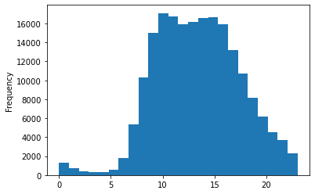
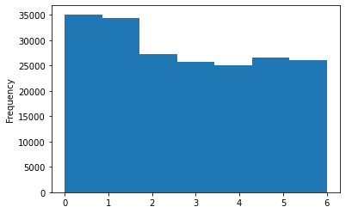
Our costumers
Hours of the day
Days of the week

Slide 12
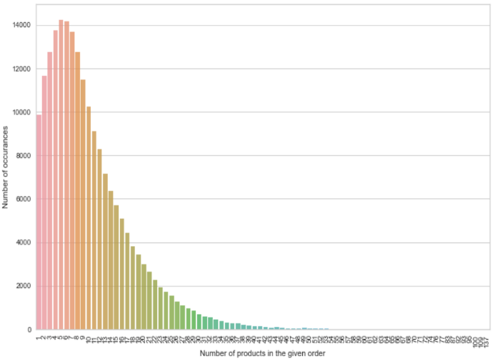
Our costumers
Orders tend to not be that big, averaging around 8 products. Just the essencials that are missing around the house.

Slide 13
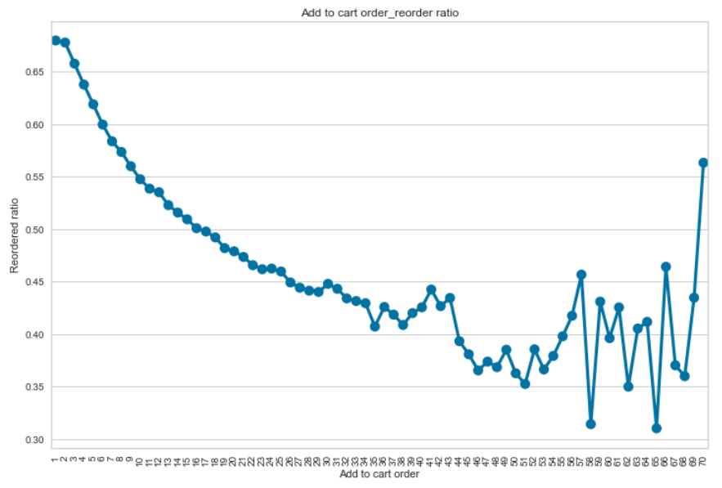
Our costumers
After trying the app for the 1st time, when making his next orders is likely to find clients re-ordering products.

Slide 14

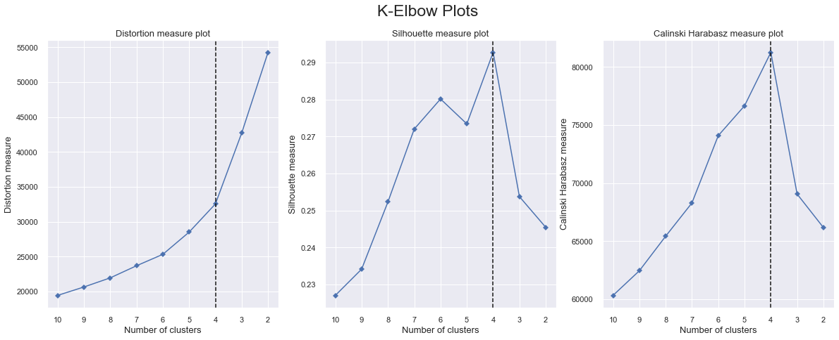
How did we do it?
Preprocessing:
Feature engineering to create better clusters.
Data Mining:
K-means clustering: partition n observations into k clusters in which each observation belongs to the cluster with the nearest mean (cluster centroid).
Variables:
['order_dow’,
'order_hour_of_day’,
'days_since_prior_order’,
'number_of_items’,
'%_of_reordered']
'rsq is:'
0.53

Slide 15
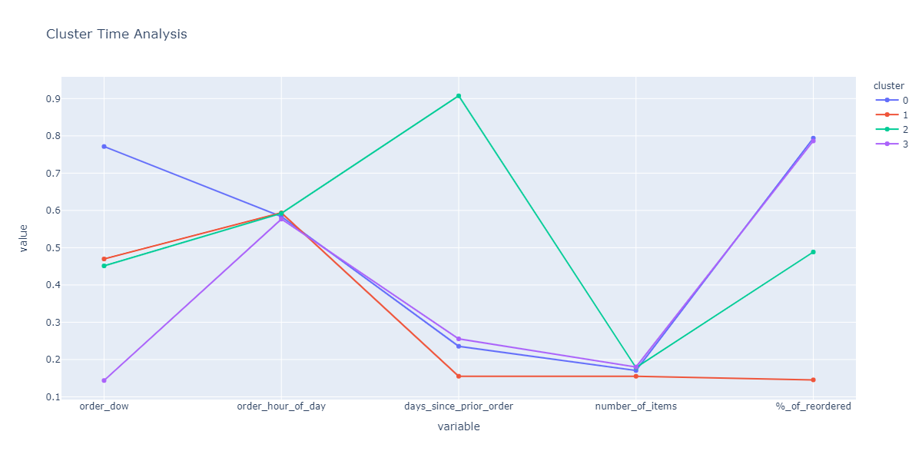
Consumer behavior
Cluster 0 “Weekend Usual Purchase”:
- Low to medium number of products
- End of the week purchases
- Buys mostly the same products
Cluster 1 “First Try Purchase”:
- New costumers
- Middle of the week purchases
- Lowest number of items purchased.
Cluster 2 “Last Purchase”:
- Churned costumers
- Middle of the week purchases
- low to medium number of products
Cluster 3 “Monday Usual Purchase”:
- Low to medium number of products
- beginning of the week purchases
- buys mostly the same items

Slide 16
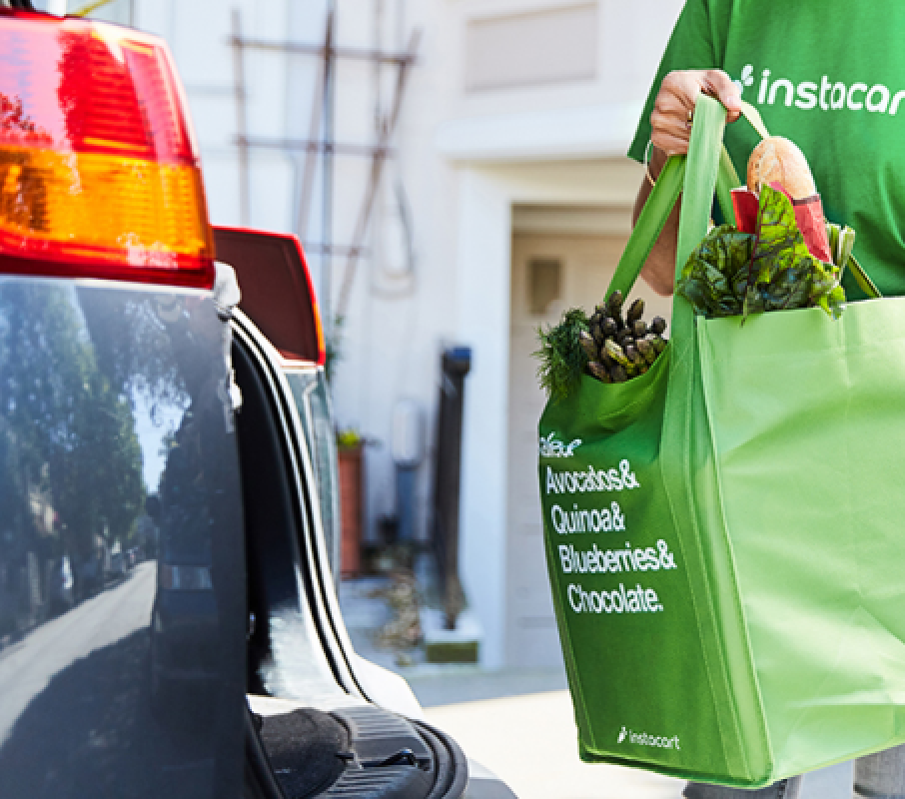
Thank you!

